Slide 1
OxLEP: ‘Making a Difference – Supporting Business and Communities’ 21 December 2021

Slide 2
Introducing OxLEP
As the Oxfordshire Local Enterprise Partnership, it is our role to champion the county’s economic potential, acting as a catalyst and convener to drive a dynamic, sustainable and growing economy.
-
Since our launch in 2011, we have made considerable progress in strengthening Oxfordshire’s economy by establishing robust and effective relationships between businesses, academia and the public sector.
-
Our remit includes; securing investment for major programmes in Oxfordshire, providing direct business support, creating meaningful discussions between business and education, attracting international investment into the county and showcasing the various world-class economic strengths in the county.

Slide 3
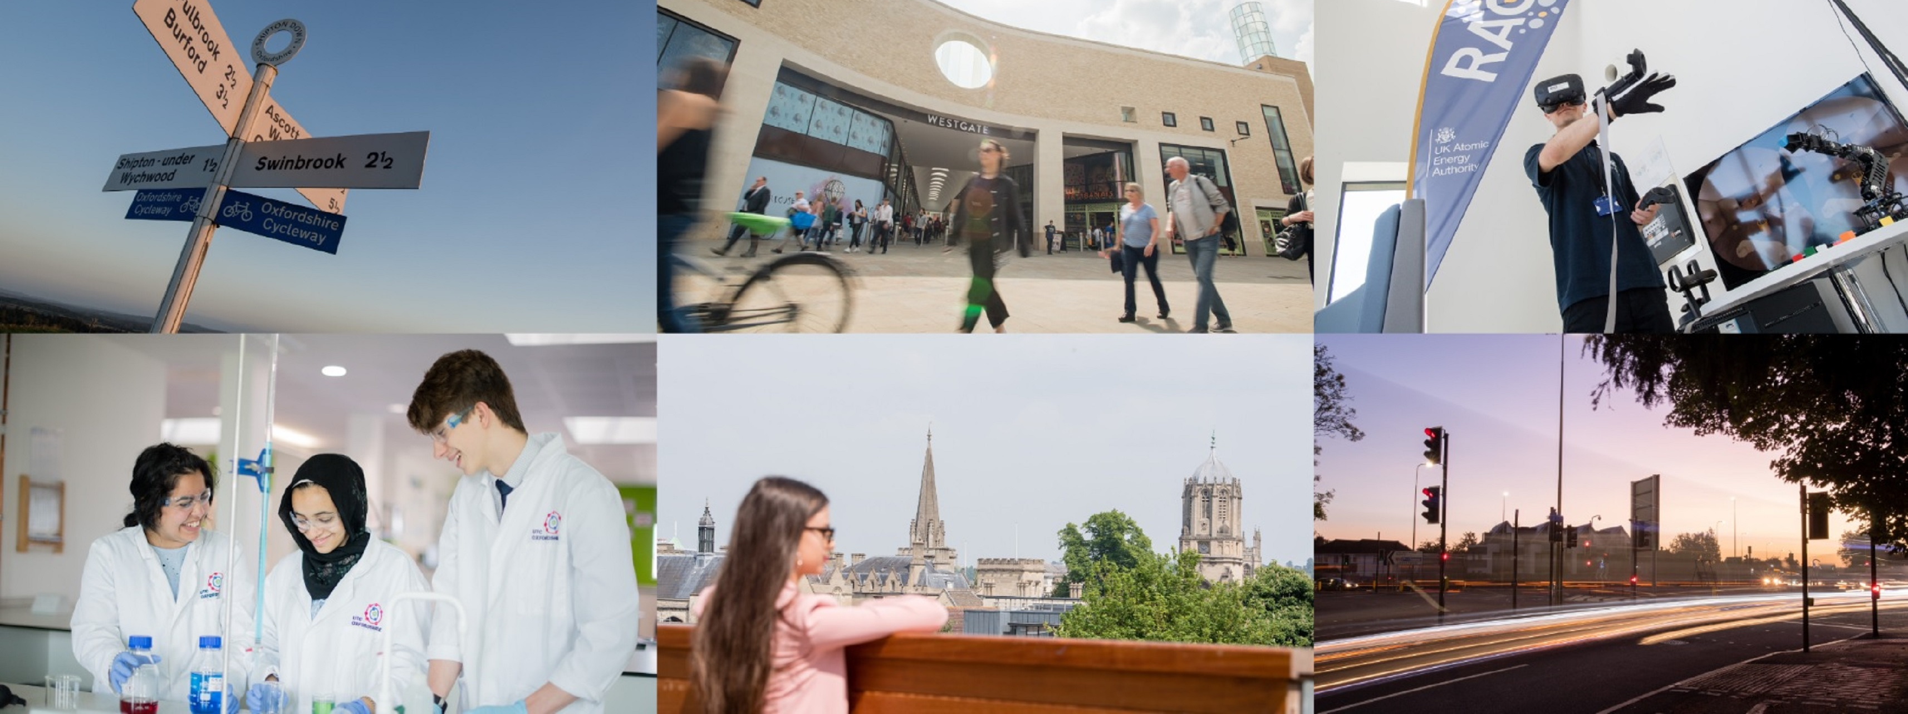
Key statistics you perhaps didn’t know:
£1bn – the amount of funding we have secured for Oxfordshire, leveraging opportunities for the county’s businesses and communities.
£3.1bn – the value of the growth programme for Oxfordshire currently overseen by OxLEP.
65,000 – the number of new jobs created in Oxfordshire from our launch in 2011 to 2019.

Slide 4
And since the pandemic, we have:
Engaged and supported around 2,600 Oxfordshire businesses (and counting).
Provided over 12,000 hours of support to businesses across multiple sectors and of all sizes.
Launched and committed £2m-plus of critical funding via our Business Investment Fund.
Administered in excess of £5million-worth of direct funding into businesses.

Slide 5
OxLEP Business Offer Helen Brind, Growth Hub Manager

Slide 7
Support available through OxLEP Business
Support available | Support covers | Relevant to
Bespoke business support plan | Accessed through online Triage tool – sign posts to all available support appropriate to business | All stages
Small Business Accelerator 5 weeks (5 modules) | Series of webinars and drop in surgery covering – for example creating and testing your own business plan, set up business/start up guide, launching new product or service, business planning for growth | Pre start, early-stage business or pivoting business plans.
Mentoring coaching and one to one support | With over 20 experienced advisors to choose from, access to mentoring, coaching or business advice, to explore overcoming business challenges and developing your organisation in the following areas. For example: Business Planning and Resilience Customer Demand / Sales & Marketing Finance & Cash-flow Your organisation and processes | Various
Foundations to Growth – 6 weeks | Businesses will benefit from access to a new support network, new tools for collaboration, improved leadership and management skills, an understanding of the foundations for growth and inspiration and motivation to grow – 6 weeks | Growth businesses
Notes:
`

Slide 8
Support available through OxLEP Business
Support | Support covers | Relevant to
NED for a Day – 8 – 10 hours of focussed support | Agreed priorities which help growth, support where we can help to create jobs, or significantly safeguard jobs. | Growth/scaling businesses
Webinars, power hours and surgeries | Variety of webinars for example: Four Principles of LI Success, Net Zero and Sustainability, How to Find Your Ideal Clients on LI, Seven Steps of Social Selling, Pitch for the Future | All stages of businesses
Go Create grants (Innovation) – revenue and capital | Matched grants up to £50k | Business looking to commercial an Innovative product/services.
Peer Networks | Variety including Women in Leadership/work/International Trader Network/ | Various stages/options depending on business
Start Up Bootcamp | Designed to give a solid foundation to developing a successful business that focuses on helping the local community, or creating a positive social or environmental impact | Start Up

Slide 9
Support available through OxLEP Business
Support | Support covers | Relevant to
Visitor Economy Recovery Support | Marketing Oxfordshire as a COVID secure location Improving competitiveness and resilience – ongoing support for businesses to be COVID safe Technology adoption fund – i.e. grants to increase online presence and trading Oxford Pass and grow conference market Additional to existing Meanwhile in Oxfordshire programme Contact Growth Hub for more details – business@oxfordshirelep.com | SME Businesses/Organisations within the sector –Creative, Cultural, Heritage and Tourism related (Including Food and Drink) Business

Slide 10
OxLEP Skills Offer Sally Andreou, Skills Hub Manager
Notes:
Hello, For those of you who we’ve not met, I’m sally Andreou, skills hub manager.
I’m going to share the strategic direction of the Skills team and provide a basic, then the team leads will provide a more in depth information. You’ll also get a chance to meet everyone from the team in a minute.

Slide 11
Oxfordshire Skills Hub
Supporting the needs of local employers through a more integrated and responsive approach to education and training.
Ensuring young people are better prepared for the world of work through programmes like work experience and education business links.
Ensuring those marginalised or disadvantaged from work are moved closer to the labour market as well as encouraging older workers to consider vacancies in areas of skills shortage.
Supporting the government’s agenda to increase the number of apprenticeships offered and taken up.
Investigating how Oxfordshire as a place of employment is promoted to graduates in our HE organisations and how more graduates can be retained to meet the demand our businesses have for higher-level skills.
Skills@oxfordshirelep.com

Slide 12
The Oxfordshire Apprenticeship Awards
Established in 2015
Sponsored, judged and awarded by business
Managed by OxLEP Skills
Promotes and celebrates Apprenticeships as an alternative career route to H.E.
Open to Apprentices of all levels and abilities and all size of business
#OAAwards2022
https://www.oxfordshirelep.com/oaawards2022

Slide 13
Oxfordshire Apprentice Ambassador Programme
Currently 15 Ambassadors from a variety of industries undertake their role, on a voluntary basis to promote vocational pathways as an alternative to Higher Education.
They support and influence a wide range of key stakeholders including schools, colleges on their:
Choice of career pathway
Job
Industry sector
Skills@oxfordshirelep.com

Slide 14
The Careers and Enterprise Company (CEC) and OxLEP’s co-investment: ‘Helping every young person in Oxfordshire find their next best step’
49 secondary schools in the Enterprise Advisor Network (EAN)
24 (of the 49) secondary schools in the CareerS Hub
4 CEC/OxLEP staff working with schools on creating and delivering their careers strategy
Skills@oxfordshirelep.com

Slide 15
CEC and OxLEP’s ambitions:
Support schools to deliver the Gatsby Benchmarks – the gold standard of careers delivery
Promote Apprenticeships and vocational routes
Help young people understand the Oxfordshire Labour Market
Investing
How can you get involved?
Volunteer: Become an Enterprise Advisor or support a local school careers intervention through the 'Give an Hour’ campaign
Encourage businesses to become a part of the Find Your Future Virtual Careers Platform
OxLEP’s CEC staff team can support with volunteering in your local secondary school/college

Slide 16
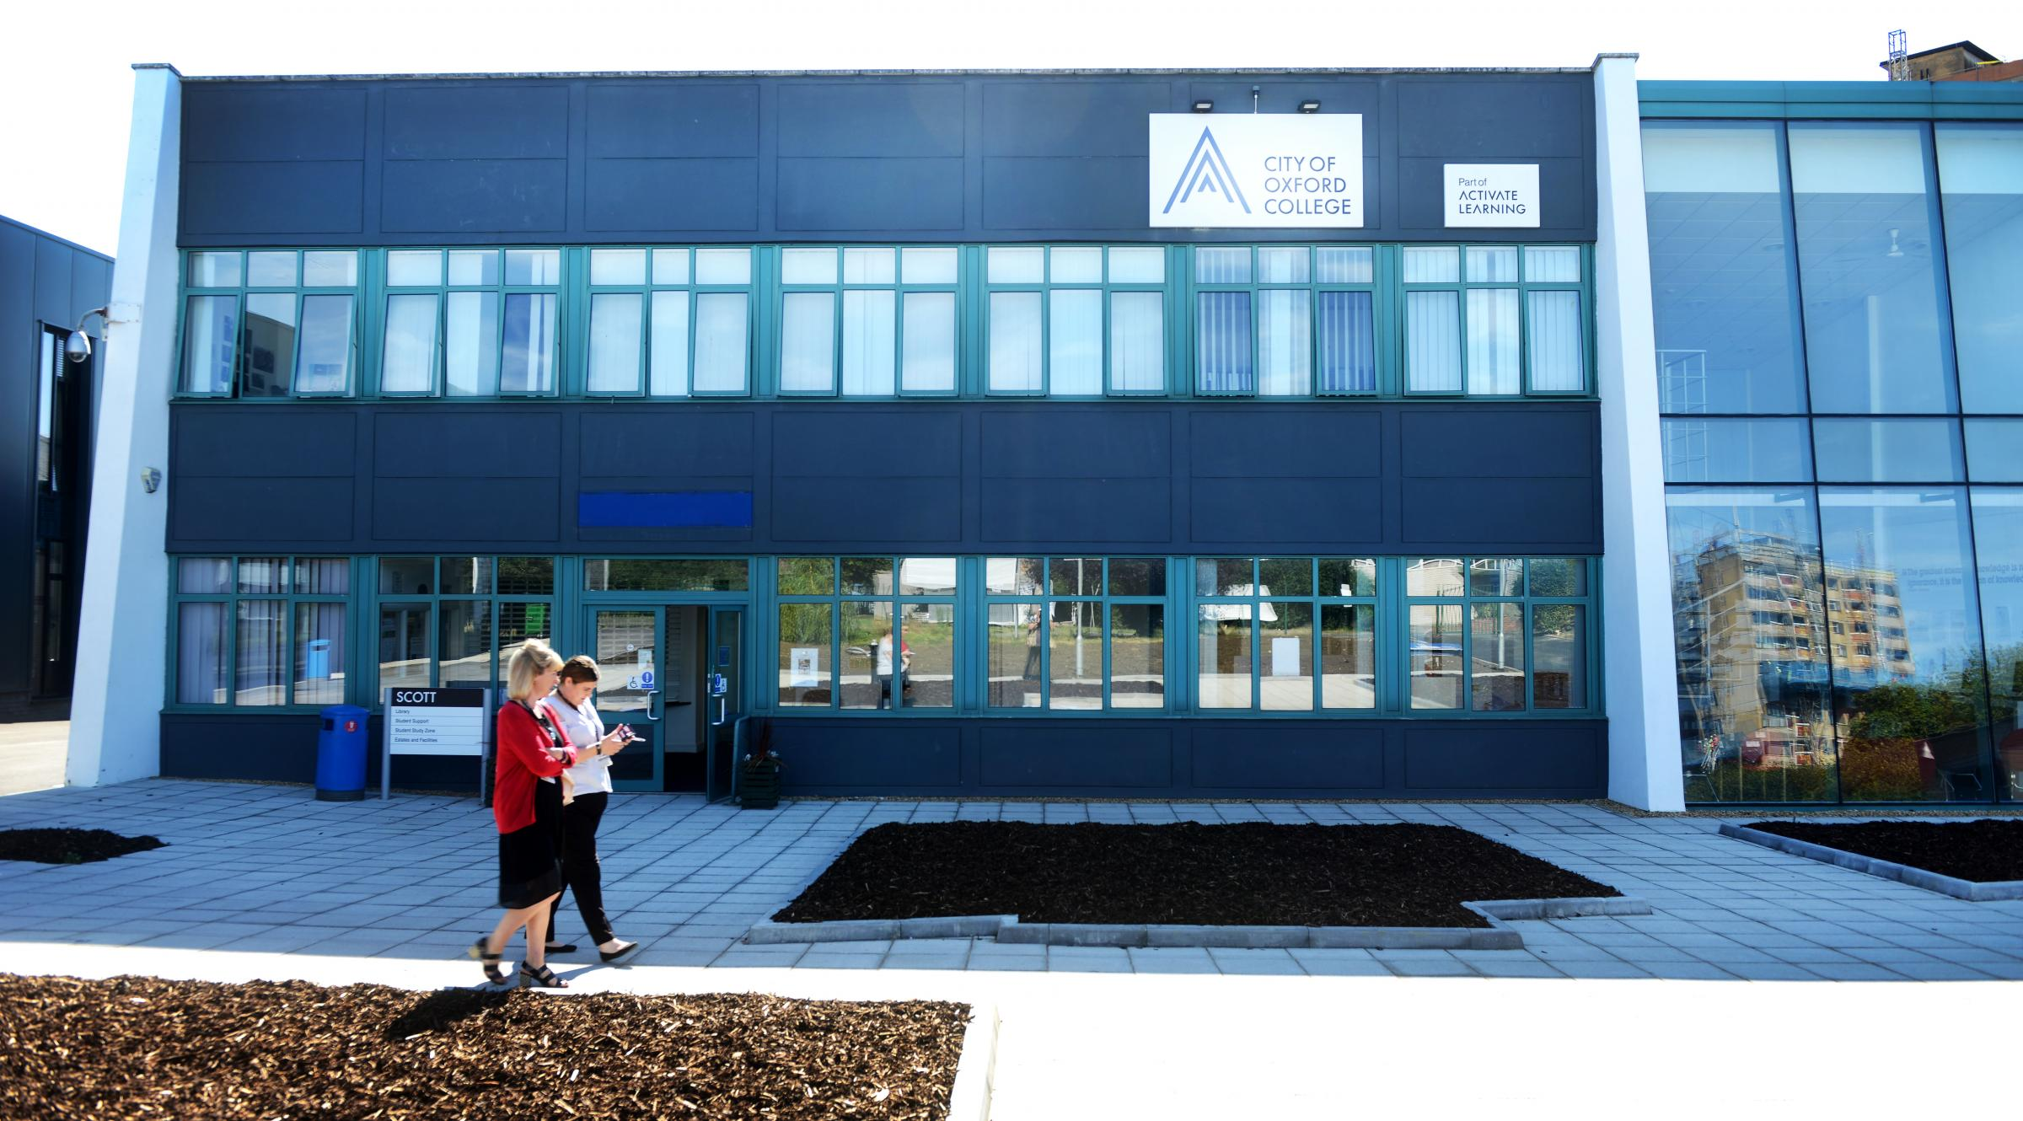
Investing in our skills infrastructure
c£24m invested in:
STEM centre
Care suite
Digital Skills Suite
Agri-tech/food security
Advanced Skills Centre
Green Construction Skills Centre
Hospitality Centre

Slide 17
Questions & Discussion

