Slide 1
Didcot Gateway Offices
Didcot Town Council public meeting update
7pm 21 December 2021

Slide 2
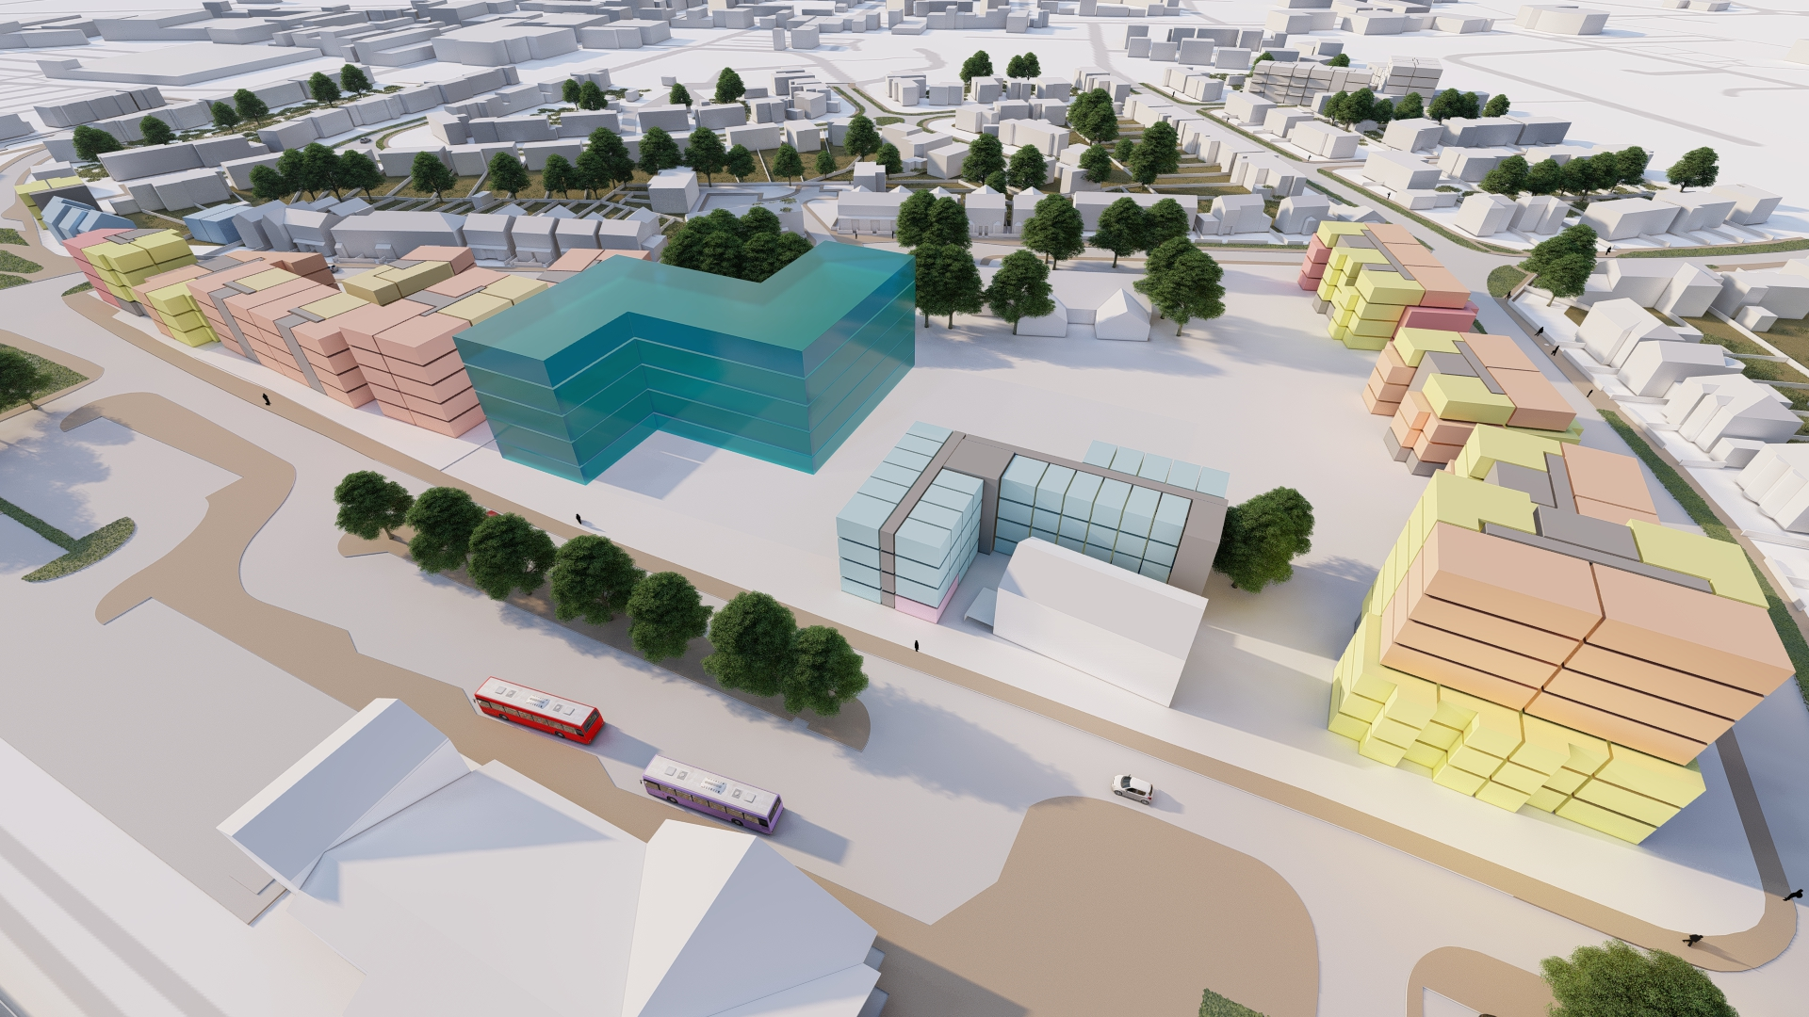
requirements
What?
A new headquarters for South Oxfordshire District Council and Vale of White Horse District Council to facilitate agile working
How big?
Council space requirement
Commercial space
Enhanced circulation
How?
BREEAM Excellent
40% reduction in carbon emissions
Integrate with development proposals for the wider area – the masterplan.
Previous Didcot Gateway masterplan imagery
Notes:
This slide shows how the councils office fits into the wider Didcot Gateway masterplan – a lot of work has been undertaken to co-ordinate the two projects and to ensure that our office complements and supports the regeneration of the Gateway area.

Slide 3
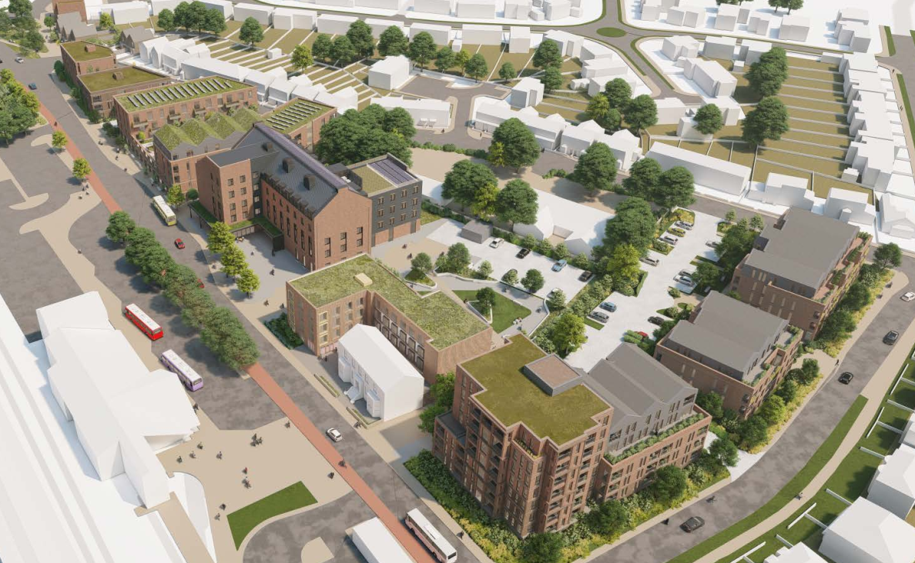
Masterplanning the Gateway area
A process has been undertaken to deliver a masterplan to ensure that our building and site design fit in with and co-ordinate with the development proposals for sites owned by other landowners, such as Homes England who own much of the rest of the Gateway area
The masterplan proposals provide context and support for planning applications on individual sites
Individual applications are then considered by planning on their own merits, in the context of the masterplan
This presentation covers the councils office site, but cannot cover issues relating to land owned and controlled by others.

Slide 4
CONCEPT DESIGN
Cabinet have approved the concept design and the move to the next detailed design stage
Further cabinet decision required to enter into contract to deliver the building.
Continual review of our office accommodation requirements, the financial viability of the programme and our sustainability outcomes.
Notes:
A brief summary of the stage in the design process and the next steps, including ongoing business case review.

Slide 5
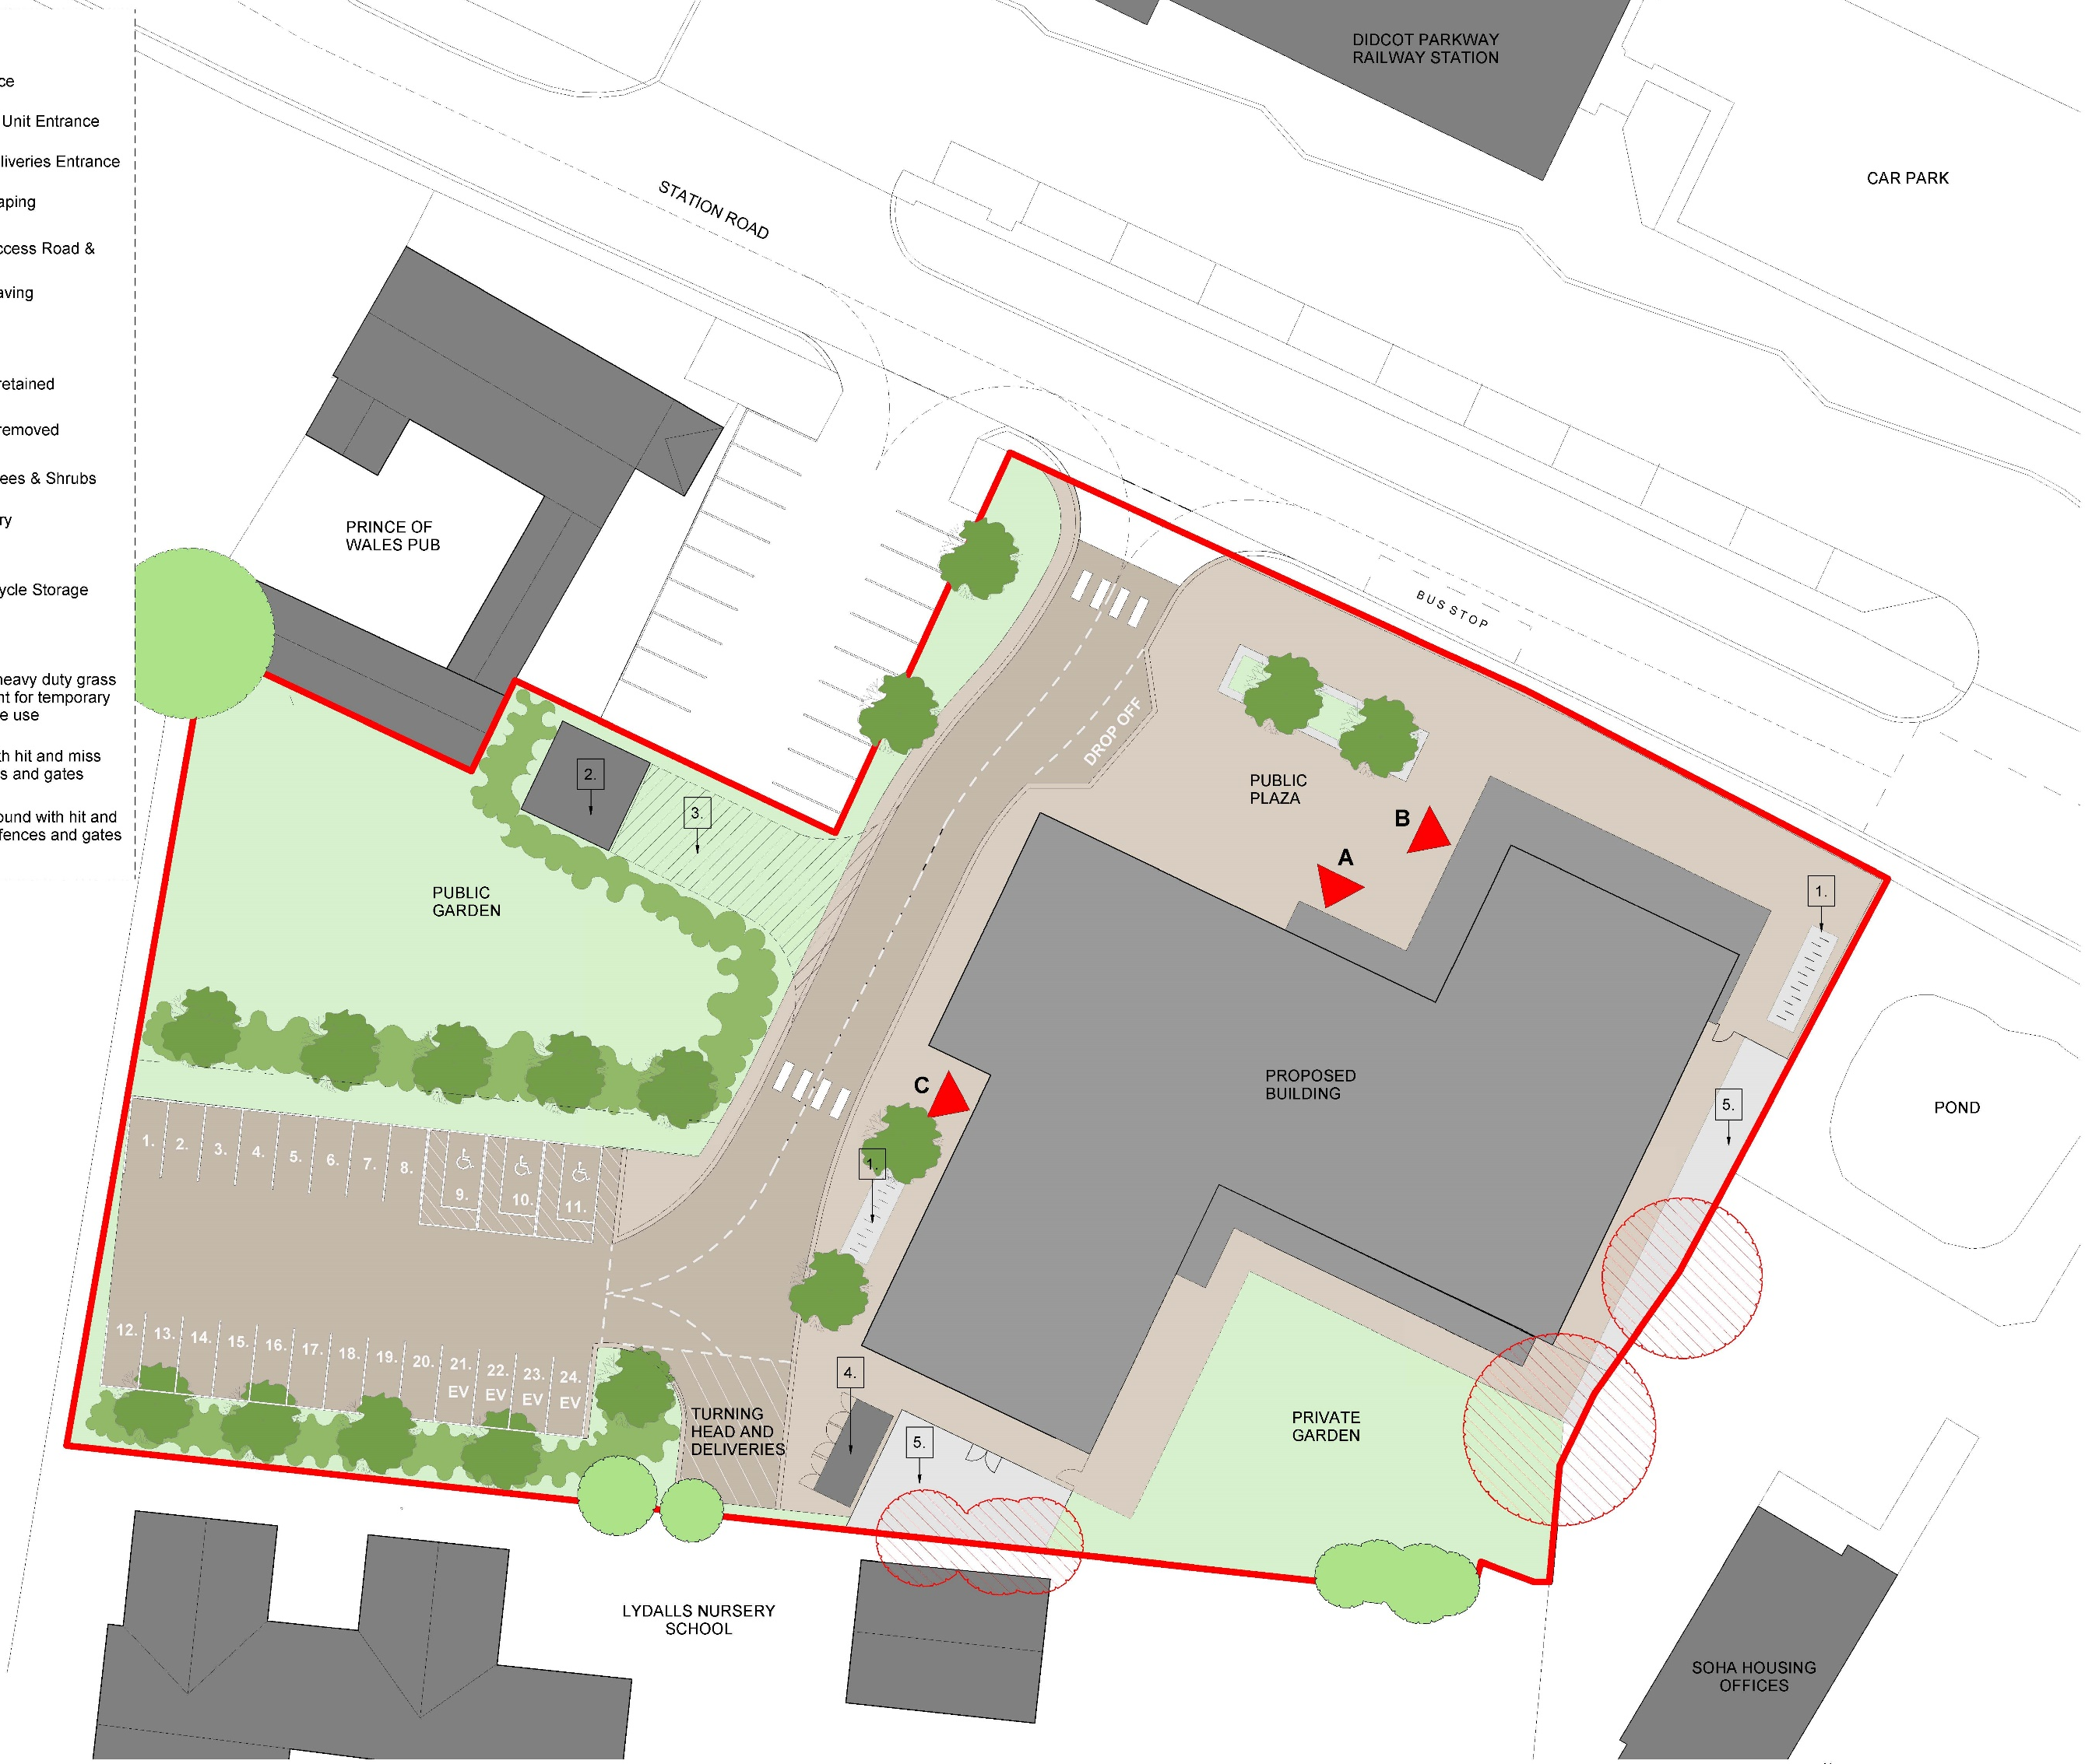
Site plan
Site Strategy
Addresses the railway station, improving the arrival experience into Didcot
Multiple external amenity spaces
Coffee shop with outside seating contributes to an active frontage
Notes:
This building has been designed to improve the arrival experience into Didcot.
The shape of the building helps with this. It provides a frontage to Station Road and the Z shape opens up to welcome people on their approach to town.
The site is surrounded on three sides by existing and proposed public spaces.
A commercial unit (coffee shop) is planned in the north wing, facing the plaza and the busy road.
Public spaces are located towards the front of the building, accessed directly from the public plaza.
The southern wing provides a separate entrance for both council staff and tenants to access the staff WC and shower facilities. This entrance also serves as a delivery entrance, with direct access to the post room.
The car park is located to the rear of the site, freeing up green space to become a public garden with links through to the residential development next door

Slide 6
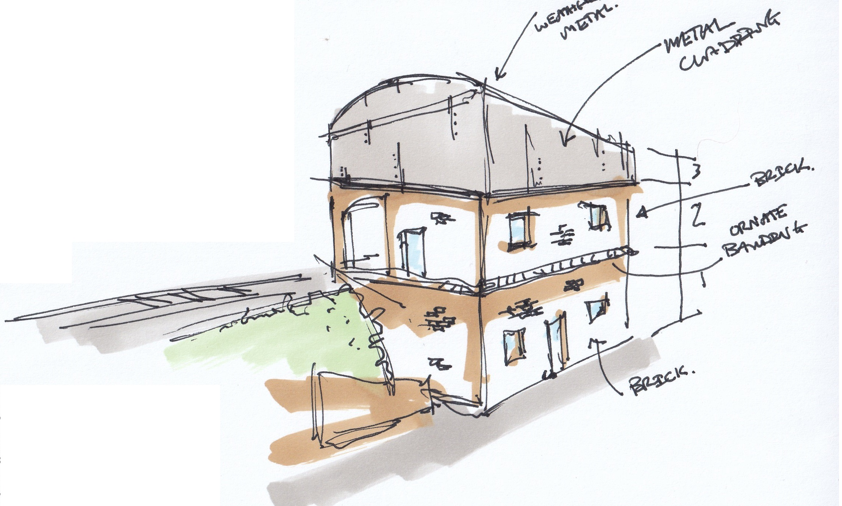
Design influences - The railway
Functionality expressed through form
Growth and industry
Notes:
Moving on to the design influences for the building - The site’s strong connection to the railway became a significant source of inspiration in developing the building. Ridge worked to respond to and reflect the industrial forms and materiality. The traditional engine shed buildings functionality is expressed through their form – the strong gables, brick detailing, early ventilation systems drawing air in through the gables and extracting out through the roof vents. These buildings were built to last and represent growth and industry.

Slide 7
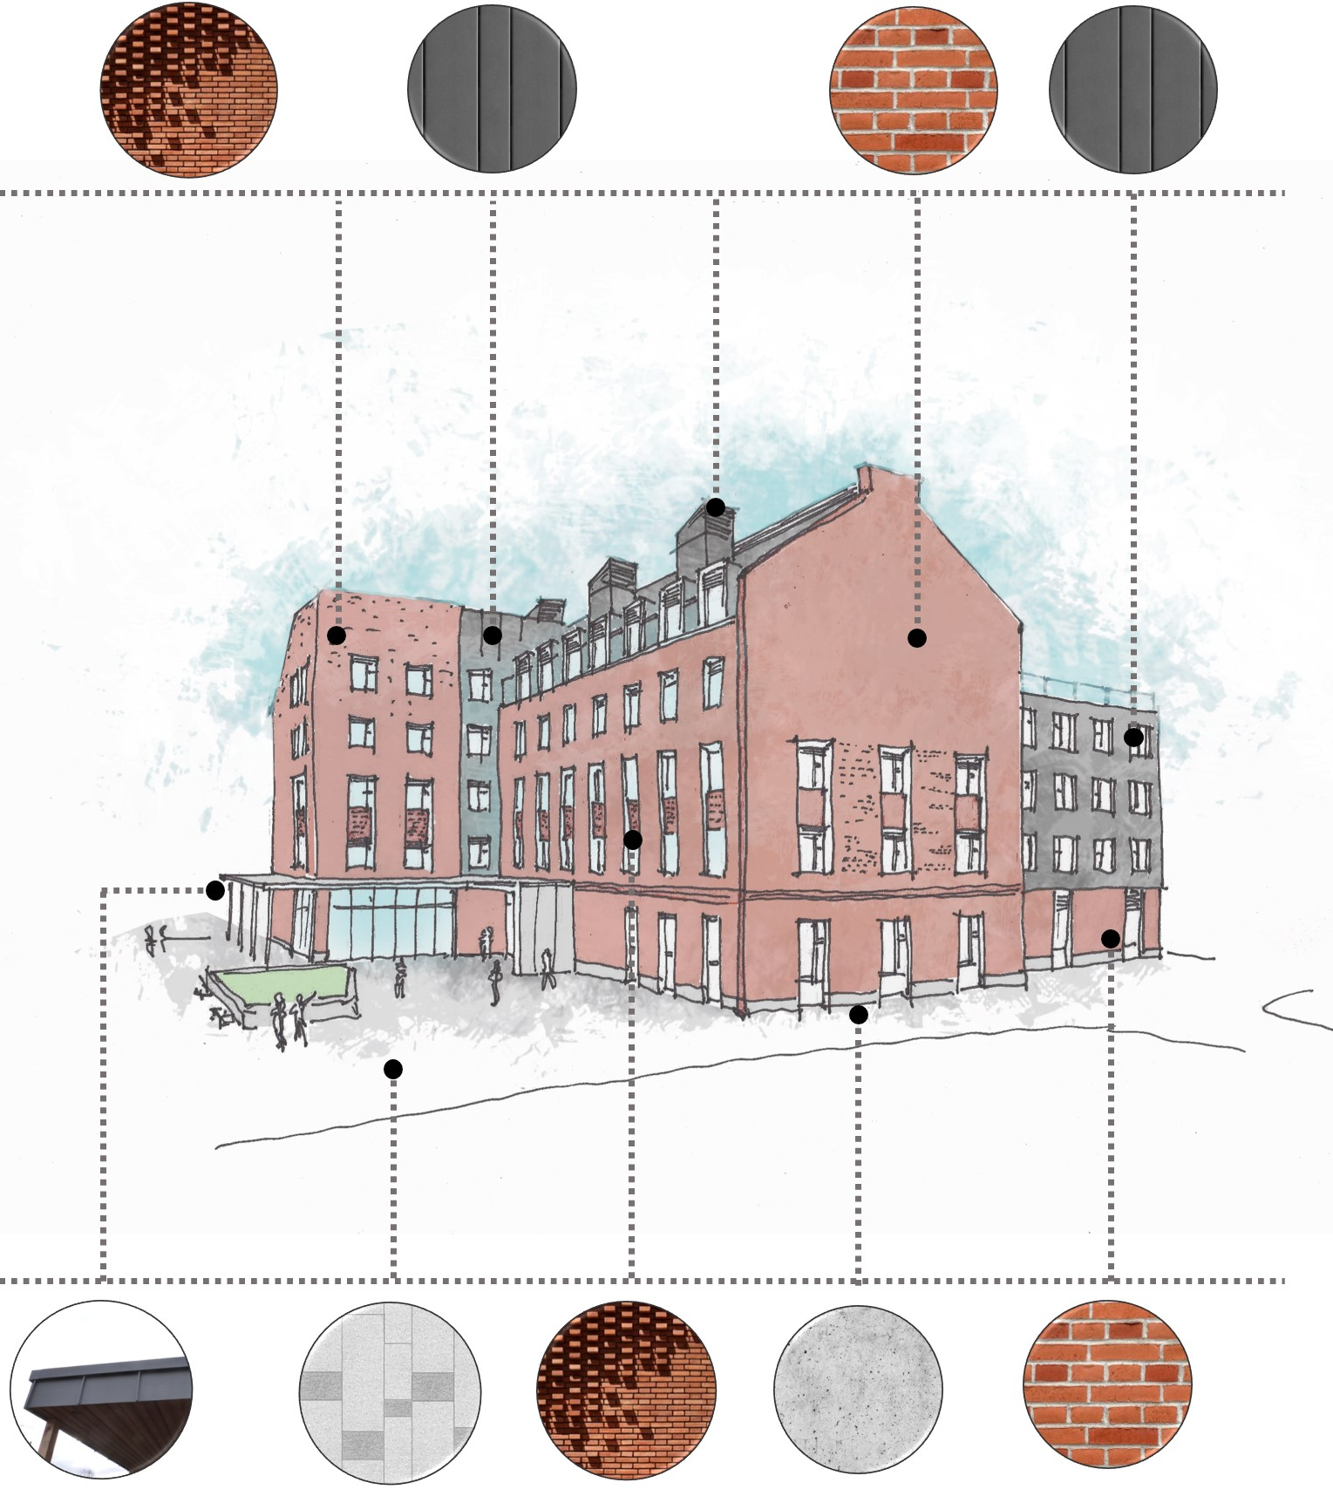
attributes
Materials
Brick represents strength, solidity and permanence and can be reused at the end of the buildings life
Zinc is low maintenance and is easily recycled
Green walls support biodiversity
Solar shading to east, west and south facades
Triple glazing with automated opening windows for natural ventilation and night time cooling
Notes:
The material palette takes reference from the wider area. Materials have been chosen with robustness, maintenance and longevity in mind.
Brick represents strength, solidity and permanence and can be reused at the end of the buildings life
Zinc looks similar to the corrugated metal used on the railway buildings and is super low maintenance and is really easy to recycle when it’s no longer needed
Green walls soften the external appearance and improve biodiversity, attenuate rainwater and remove air pollutants.
Windows are triple glazed……….

Slide 8
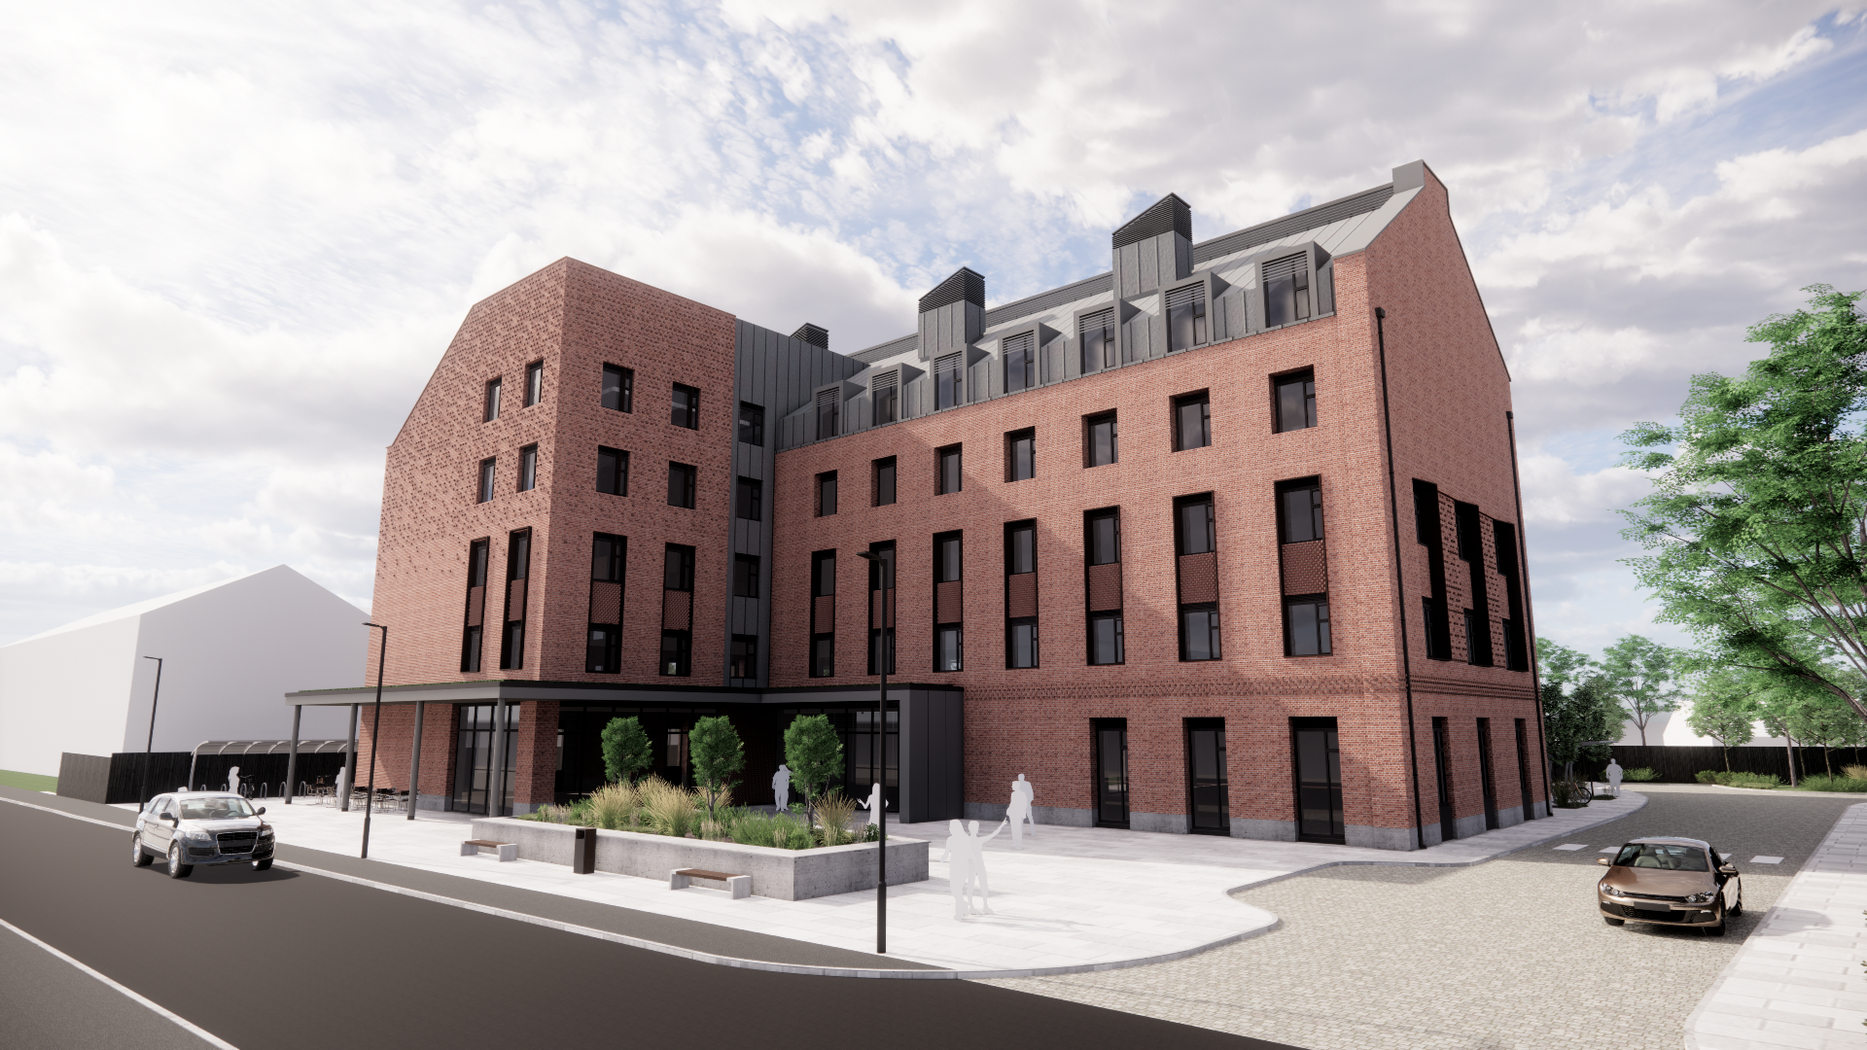
Notes:
This is a view from Station Road on approach from the railway station. You can see the entrance across the plaza, access to the car park, café with outside seating….
Note: The soft landscaping design work is being undertaken at the moment so minimal planting has been shown so that the building form is clear – we will are working on further planting at the moment.

Slide 9
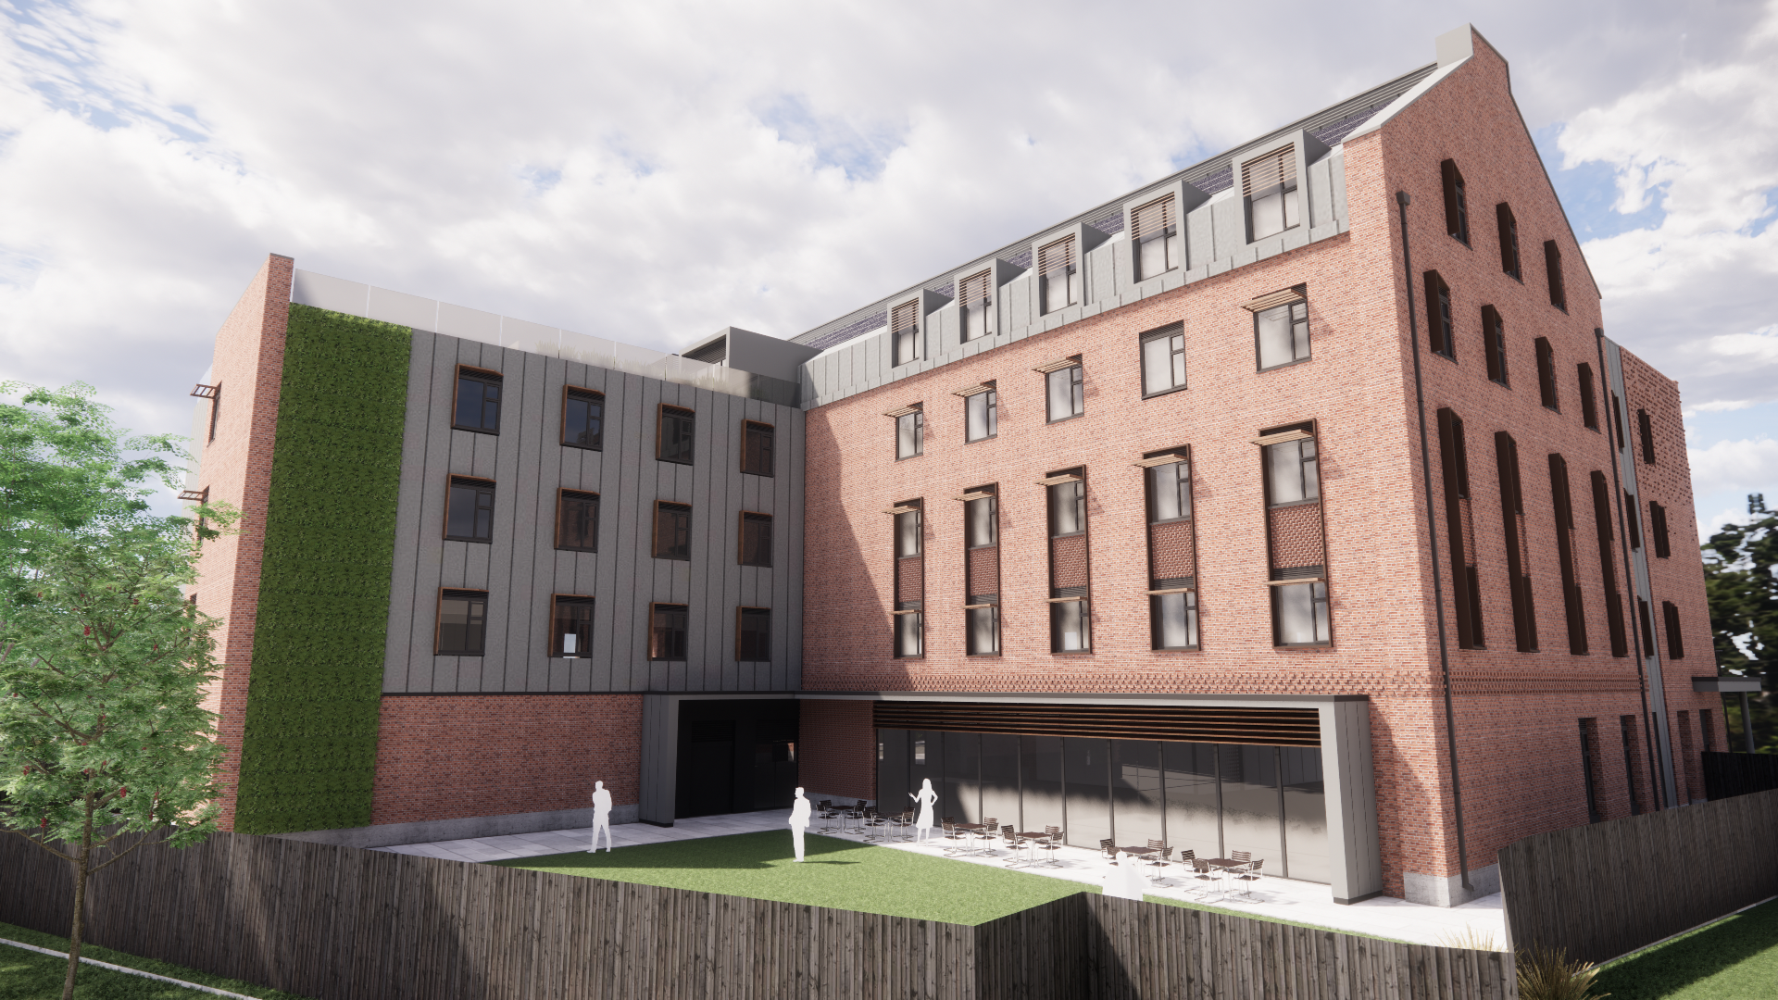
Notes:
This is a view from the south showing the private garden, accessible from the main core and the multi functional space.
Again the landscaping design of this area is being undertaken at the moment.

Slide 10
SUSTAINABILITY

Slide 11
Des 10
Key Requirements for Major New Non-Residential Buildings
BREEAM Excellent Rating – plus:
From Dec 2020 – 40% Reduction in Emissions
From March 2026 – 50% Reduction in Emissions
From March 2030 – 100% Reduction in Emissions
(note – considering regulated energy only)
However the – “Council is aiming to achieve net carbon neutrality by 2025”
What have we considered?
Compliance with current DES 10 requirement – 40% Reduction
Achieve the 100% Reduction
Achieving full Net Zero Carbon – for operational energy
Notes:
The sustainability aspirations for the building are very strong and have been embedded throughout the design process.
The building will generate all the ‘regulated energy’ (for heating and lighting etc) on site.
The building will have a super insulated structure and will be triple glazed.
Where possible ventilation will be passive.
There will be no gas supply and heating will be using air source heat pumps.

Slide 12
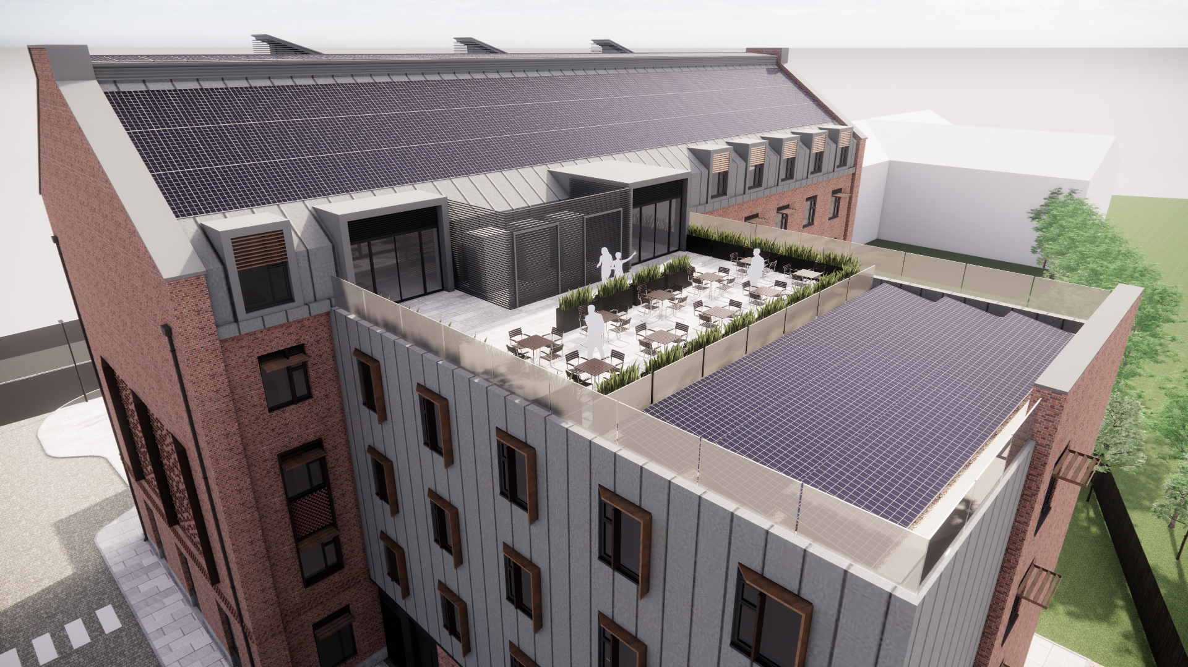
Notes:
A view of the roof showing the PV panels and roof terrace.

Slide 13
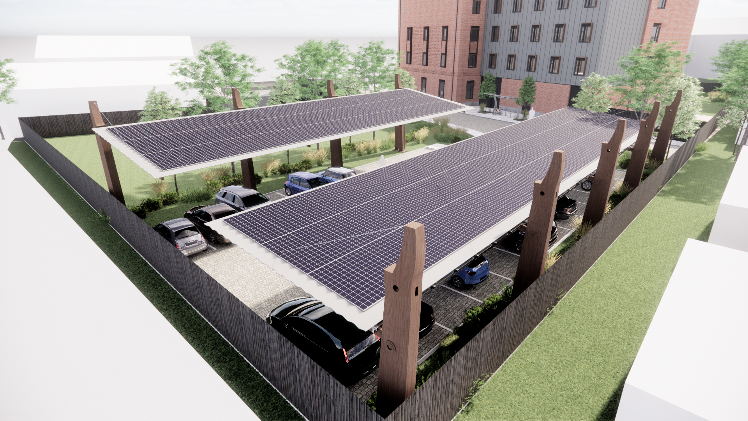
Notes:
A visual showing PV panels over the car park to maximise on site electricity generation.
We anticipate all on site car parking spaces having car charging capability

Slide 14
QUESTIONS
Notes:
Recognising that Didcot residents are key stakeholders we particularly want to encourage you to submit your thoughts and engage with the forthcoming planning consultation process when a planning application for our site is submitted early next year.

